Slide 1
Developer General Skills
Rob Feng

Slide 2
What general development skill use for developer
What is Layered Architecture?
What is Modular Architecture?
What is Unit Test?
Use Unit Test to debug;
Use Unit Test to improve Code Quality, protect business feature.

Slide 3
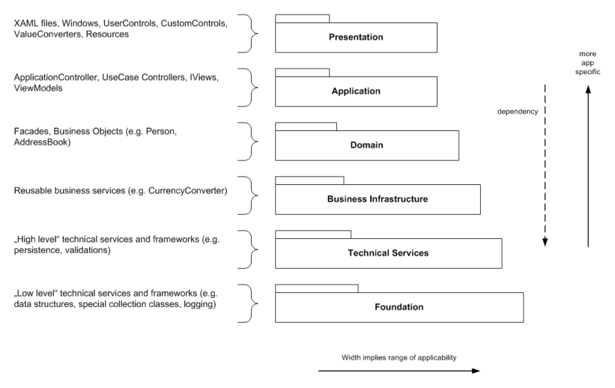
Layered Architecture
Layering is a very useful tool in structuring object-oriented software systems. It helps to organize the types and namespaces into a large-scale structure.
The layered architecture defines a few rules to ensure that the structuring is done right. One of the rules says that “lower” layers are low-level and general services, and the “higher” layers are more application specific. This way you are able to divide the software artifacts with related responsibilities together into discrete layers.
Notes:
https://github.com/jbe2277/waf/wiki/Layered-Architecture
https://www.codeproject.com/articles/36847/three-layer-architecture-in-c-net

Slide 4
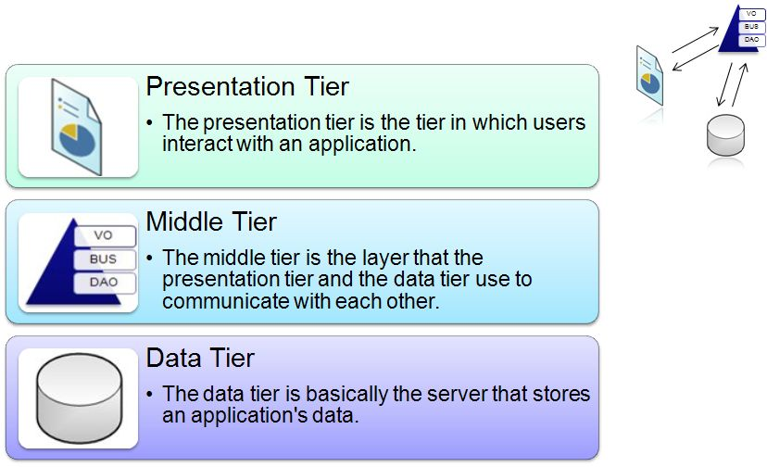
Three-layer-architecture

Slide 5
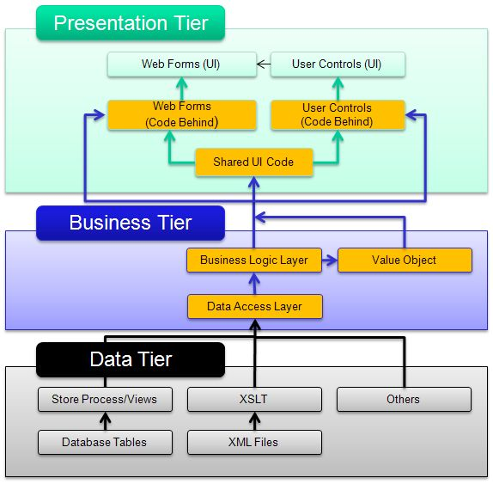
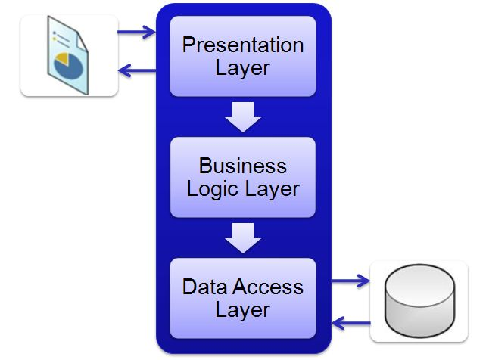
Three-layer-architecture

Slide 6
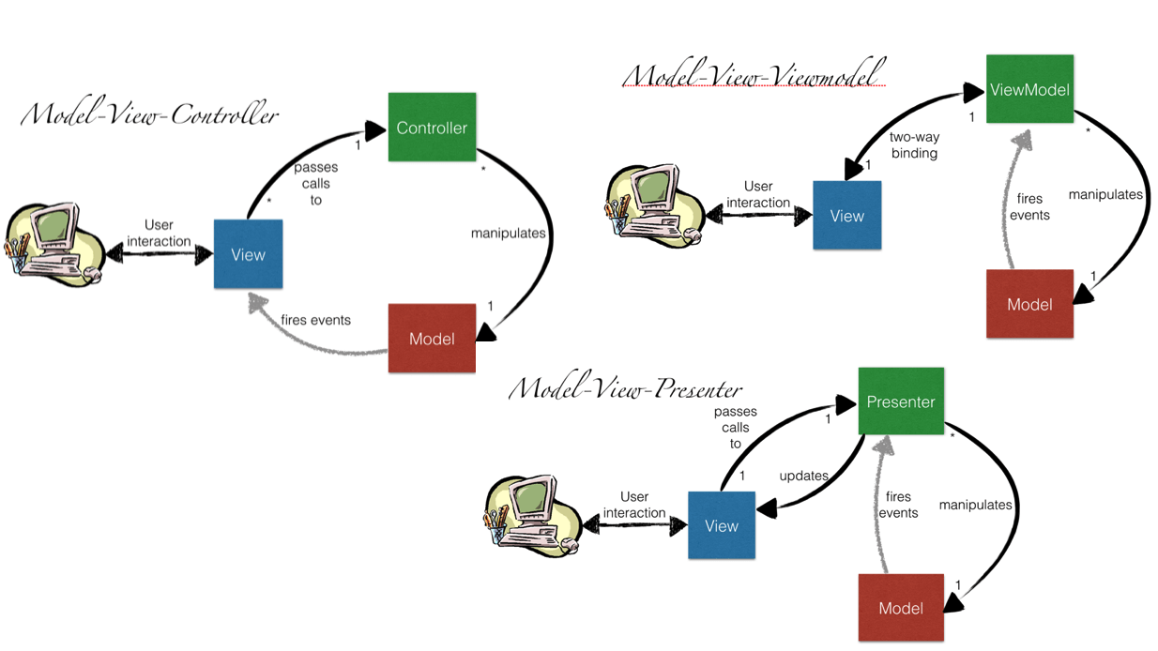
UI Design Pattern
Model–view–controller (MVC)
Model–view–presenter (MVP)
Model–view–viewmodel (MVVM)
Notes:
https://www.codeproject.com/Articles/228214/Understanding-Basics-of-UI-Design-Pattern-MVC-MVP

Slide 7
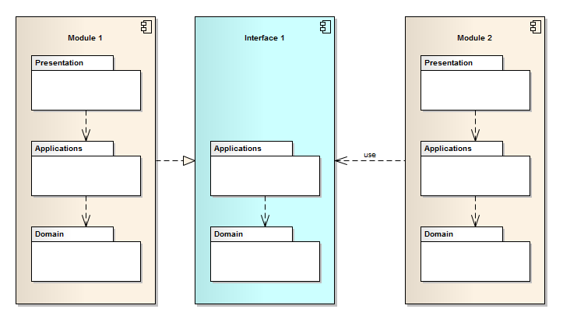
Modular Architecture
Applying the Layered Architecture for structuring a large software system into maintainable parts might not be good enough.
The Modular Architecture can solve this issue. It extends the layering by introducing another dimension to separate the software system.
Notes:
https://github.com/jbe2277/waf/wiki/Modular-Architecture

Slide 8
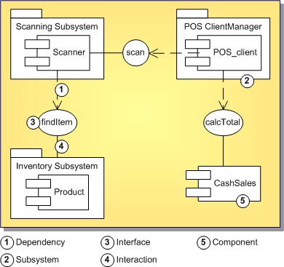
Component Design
In programming and engineering disciplines, a component is an identifiable part of a larger program or construction.
Usually, a component provides a particular function or group of related functions. In programming design, a system is divided into components that in turn are made up of modules.
Component test means testing all related modules that form a component as a group to make sure they work together.

Slide 9
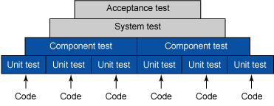
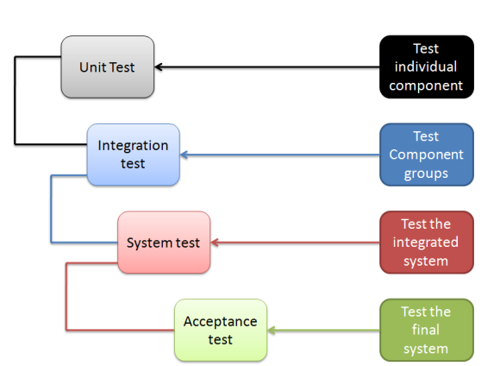
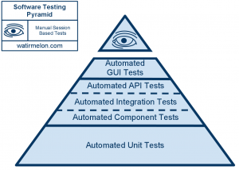
What is Unit Test?
Notes:
improve Code Quality, protect business feature
High Code Coverage
UT only focus on a unit, hard to test the function integration

Slide 10
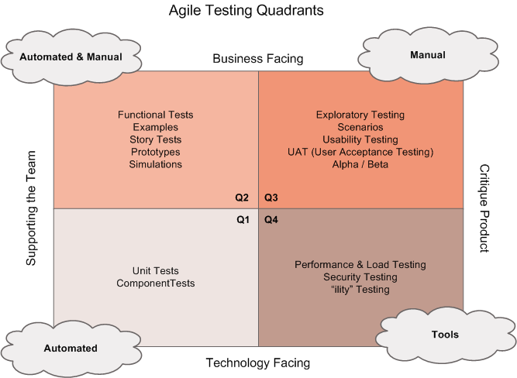
Agile Testing Quadrants

